Slide 1

Note: The data and information in this document is reflective of a hypothetical situation and client. This document is to be used for KPMG Virtual Internship purposes only.
Sprocket Central Pty Ltd
Data analytics approach
[Division Name] - [Engagement Manager], [Senior Consultant], [Junior Consultant]

Slide 2
Note: The data and information in this document is reflective of a hypothetical situation and client. This document is to be used for KPMG Virtual Internship purposes only.
Agenda
Introduction
Data Exploration
Model Development
Interpretation

Slide 3
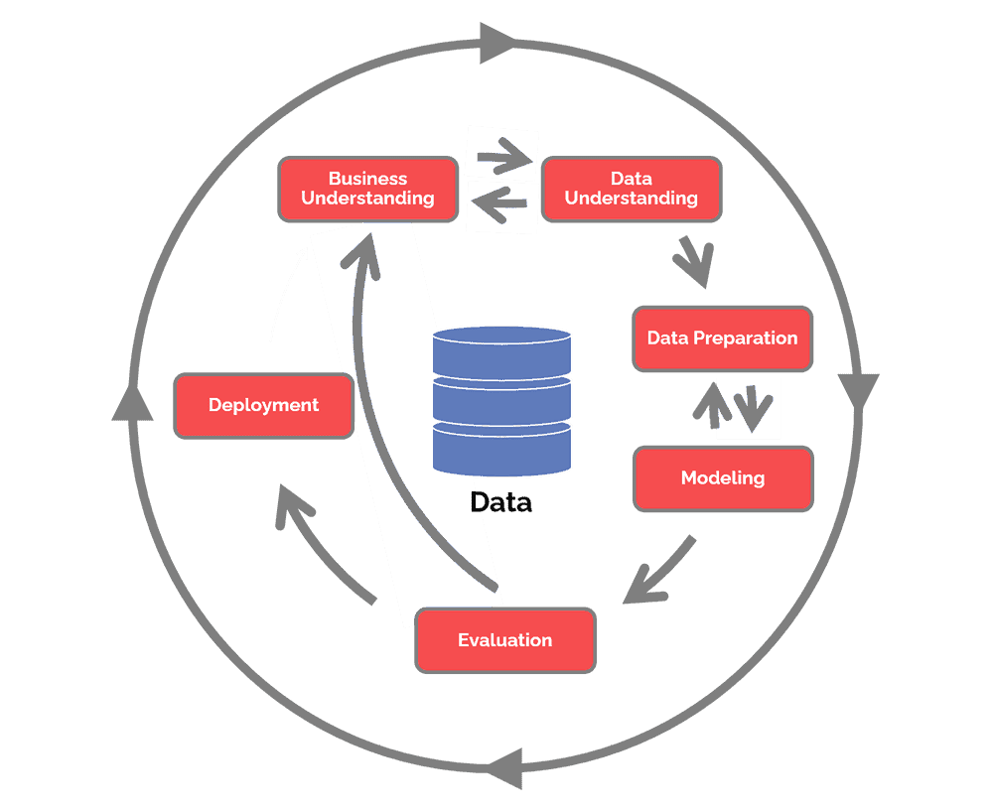
Note: The data and information in this document is reflective of a hypothetical situation and client. This document is to be used for KPMG Virtual Internship purposes only.
Introduction
Our Plan
In this presentation we will show the steps we will take in order to build our marketing strategy to know how we can attract new customers.

Slide 4
Note: The data and information in this document is reflective of a hypothetical situation and client. This document is to be used for KPMG Virtual Internship purposes only.
Data Exploration
What did we understand from the data?
Transactions table: History of order made by previous clients in 2017.
Customer Demographic: Information about customers like gender, purchases made, wealth, age and more.
Customer Address: geographical data for our clients.
Australian Bureau: we will also be doing geographical analysis by utilising the data from this website which can help us determine the best locations and points of interest for new clients.

Slide 5
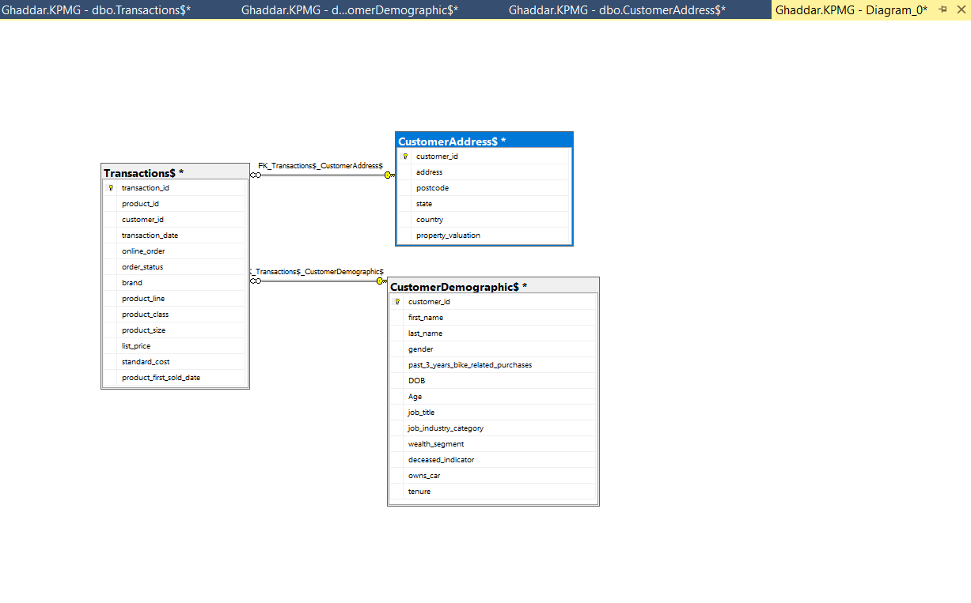
Note: The data and information in this document is reflective of a hypothetical situation and client. This document is to be used for KPMG Virtual Internship purposes only.
Model Development
Here we will show the SQL Model for your tables.
Relation between the 3 tables using the customer ID as a foreign key.

Slide 6
Note: The data and information in this document is reflective of a hypothetical situation and client. This document is to be used for KPMG Virtual Internship purposes only.
Interpretation
We will follow up with the steps below for our data analysis.
We will analyze the male and female numbers and orders per region.
We will use data insights from Australia bureau to get new insights for males and females in the recent years to compare them with what’s best for our new customers.
We can identify that way the best region, age, gender that could help us in our future marketing strategy.

Slide 7
Note: The data and information in this document is reflective of a hypothetical situation and client. This document is to be used for KPMG Virtual Internship purposes only.
Appendix

